Slide 1


The New Geography of Growth
Why East Asia and RCEP Matter More Than Ever
Yasuto Watanabe
Director/CEO
1st RCEP Business and Investment Summit
9 September 2026

Slide 2
RCEP economies have grown from one-fifth of global GDP to…
Share of Global GDP in 1990
26%
29%
Euro area
20%
North America
RCEP
Bubble size = share of global GDP
Note: Global GDP refers to World Bank’s Development Indicator nominal GDP at market price.

Slide 3
…one-third of global GDP
Share of Global GDP in 2025
15%
RCEP area also accounts for
30%
28%
Euro area
28%
of global population
30%
North America
RCEP
of global trade
Bubble size = share of global GDP
Note: Global GDP refers to World Bank’s Development Indicator nominal GDP at market price.

Slide 4
ASEAN+3 is a key part of RCEP
Share of Global GDP in 2025
ASEAN+3 accounts for
92%
Of RCEP GDP
Bubble size = share of global GDP
Note: Global GDP refers to World Bank’s Development Indicator nominal GDP at market price.

Slide 5


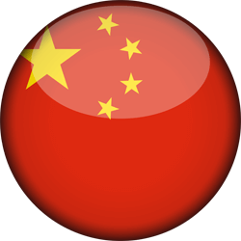



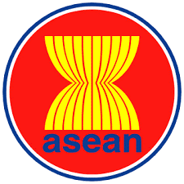

AMRO conducts close surveillance and engagement across ASEAN+3
CMIM is USD240 billion
~20% of the IMF’s financial resources
Plus-3
China
Korea
Japan
Macroeconomic surveillance
and research across ASEAN+3
Hong Kong, China
ASEAN
Technical assistance
building member capacity

Slide 6
ASEAN+3 likely to face slower growth, higher inflation, and vast uncertainties
ASEAN+3 Growth and Inflation Projections Under AI Cycle and Middle East Scenarios
(Percent, year-on-year)
Growth
Inflation
Source: ASEAN+3 Regional Economic Outlook 2026 (Interim Update); AMRO staff estimates.
Note: Estimated using the Oxford Economics’ Global Economic Model. Baseline assumes an oil price of USD90/barrel in 2026, while adverse scenario assumes that the Strait of Hormuz remains effectively closed for six months and Brent stays above USD150/barrel for four months, with sustained energy and industrial supply disruption weighing on economic activity while amplifying price pressures. Forecasts and assumptions have been revised since AREO 2026 and were presented at the ad hoc AFCDM+3 on 28 April 2026.

Slide 7
ASEAN+3 likely to face slower growth, higher inflation, and vast uncertainties
ASEAN+3 Growth and Inflation Projections Under AI Cycle and Middle East Scenarios
(Percent, year-on-year)
Growth
Inflation
Downside risks to outlook:
Technology
cycle
Middle East conflict and energy prices
Trade policy
shifts
Source: ASEAN+3 Regional Economic Outlook 2026 (Interim Update); AMRO staff estimates.
Note: Estimated using the Oxford Economics’ Global Economic Model. Baseline assumes an oil price of USD90/barrel in 2026, while adverse scenario assumes that the Strait of Hormuz remains effectively closed for six months and Brent stays above USD150/barrel for four months, with sustained energy and industrial supply disruption weighing on economic activity while amplifying price pressures. Forecasts and assumptions have been revised since AREO 2026 and were presented at the ad hoc AFCDM+3 on 28 April 2026.

Slide 8
However, ASEAN+3 would still be a major global growth driver
World: Real GDP Growth on PPP Basis
(Percent year-on-year)
Source: AMRO staff calculations

Slide 9
However, ASEAN+3 would still be a major global growth driver
World: Real GDP Growth on PPP Basis
(Percent year-on-year)
World: Share of Real GDP Growth
(Percent)
ASEAN+3
43.8
Source: AMRO staff calculations
Source: AMRO staff calculations

Slide 10
From world factory to
a regionally anchored supply chain

Slide 11
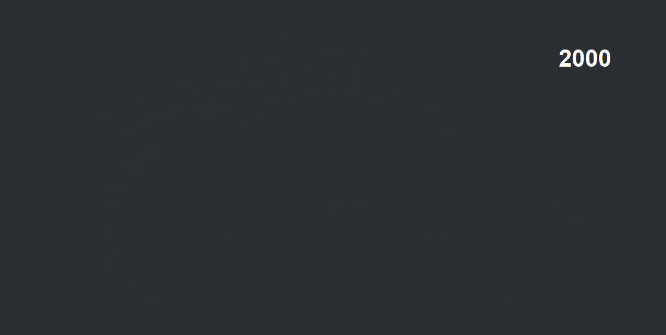
1
Regional supply chain is now denser and more integrated
Source: ADB Multi-regional Input Output Table; AMRO staff calculations.
Note: Only linkages that represent the largest import or more than 25 percent of the total import are shown. The size of the bubble represents the share of an economy’s imports in the world’s total imports. The thickness of the linkage represents the share of flow between each trading partner in the world’s total flow.

Slide 12

2
East Asia is the largest source of final demand in the world today
Global Value-added in Final Demand
(Percent share, 2000 and 2024)
US
ASEAN+3
Source: ADB Multi-regional Input Output Table; AMRO staff calculations.
Note: Only linkages that represent the largest import or more than 25 percent of the total import are shown. The size of the bubble represents the share of an economy’s imports in the world’s total imports. The thickness of the linkage represents the share of flow between each trading partner in the world’s total flow.

Slide 13
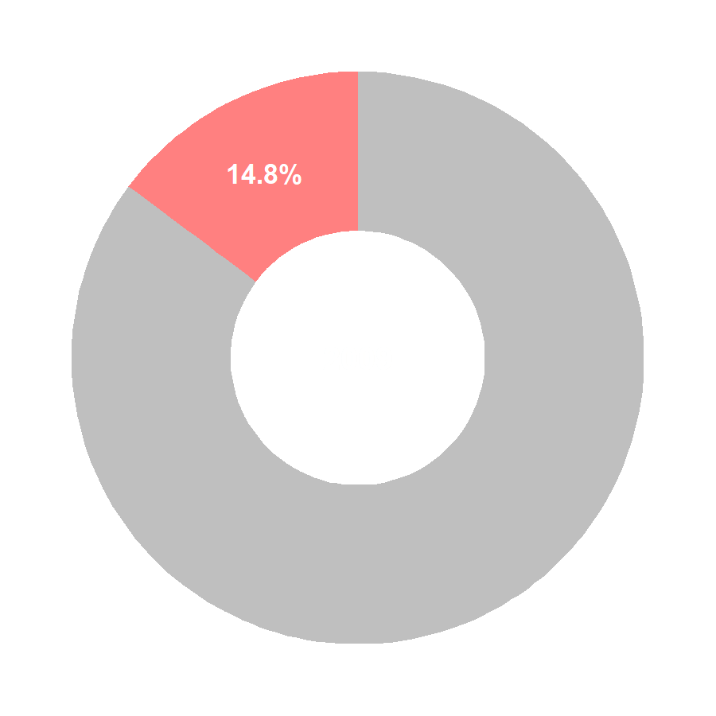
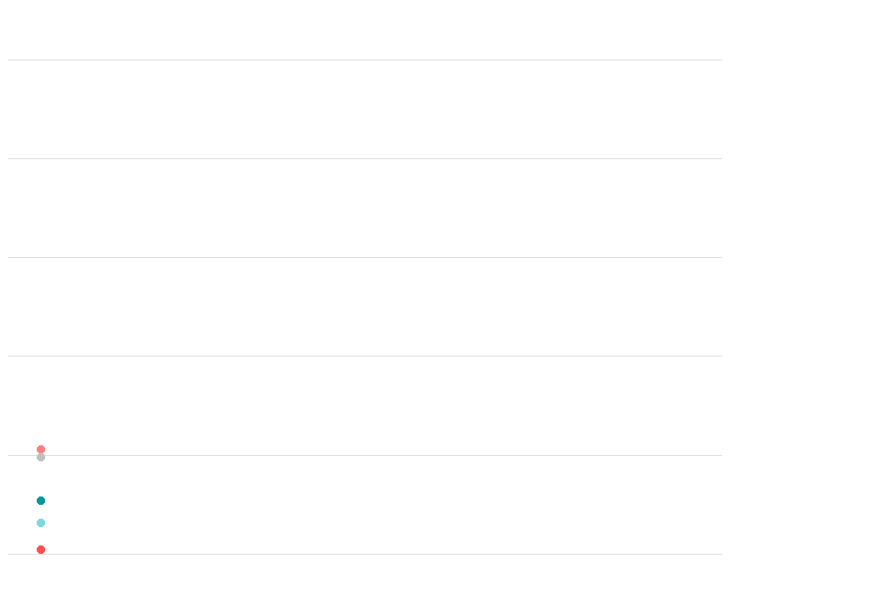
3
Investment flows reinforce integration
Global FDI Inflow Stock
(Percent share)
ASEAN: FDI Stock from ASEAN+3
(USD Billion)
1,250
ASEAN+3
1,000
Rest of World
750
US
500
EU
250
AU & NZ
0
Source: IMF CDIS; AMRO staff calculations
Note: RoW = Rest of the world; CN = China; HK = Hong Kong; JP = Japan; KR = Korea; US = United States; ASEAN-5 = Indonesia, Malaysia, the Philippines, Singapore, and Thailand; BCLMV = Brunei, Cambodia, Lao PDR, Myanmar, and Vietnam.

Slide 14
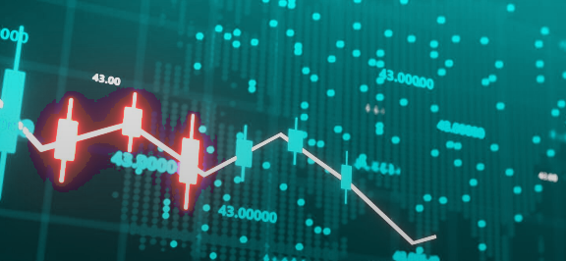
Stronger business-cycle synchronization in the region
!
ASEAN+3: Variance in Real Growth Explained by Factors, Excluding Crisis Years
(Percent)
The world matters.
So does the region.
Regional factors now explain as much growth variance as global ones
Source: World Bank; AMRO staff calculations
Note: Crisis years refer to the global financial crisis (2008–2009) and COVID-19 (2020–2021). The variance in real growth is decomposed into shares explained by global factor, regional factor, and idiosyncratic economy-specific fluctuations, based on an estimated dynamic factor model following He and Liao (2012).

Slide 15
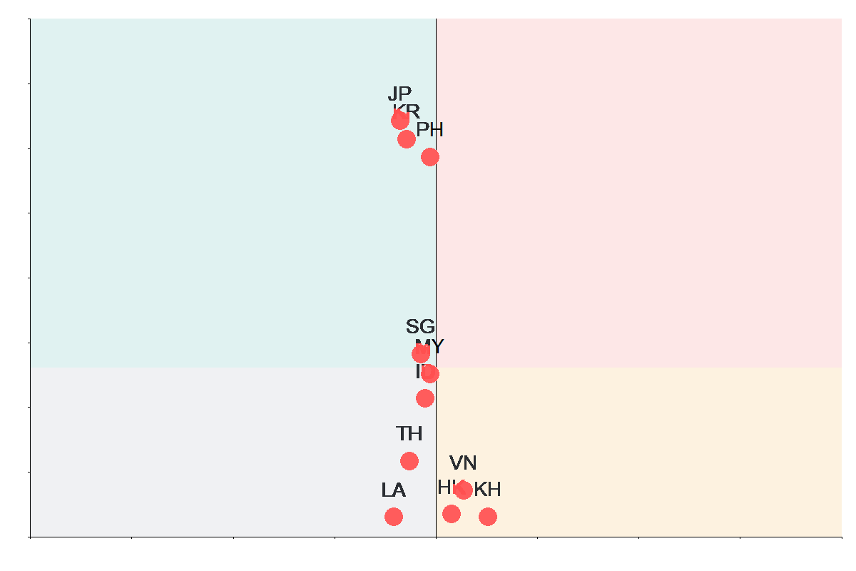
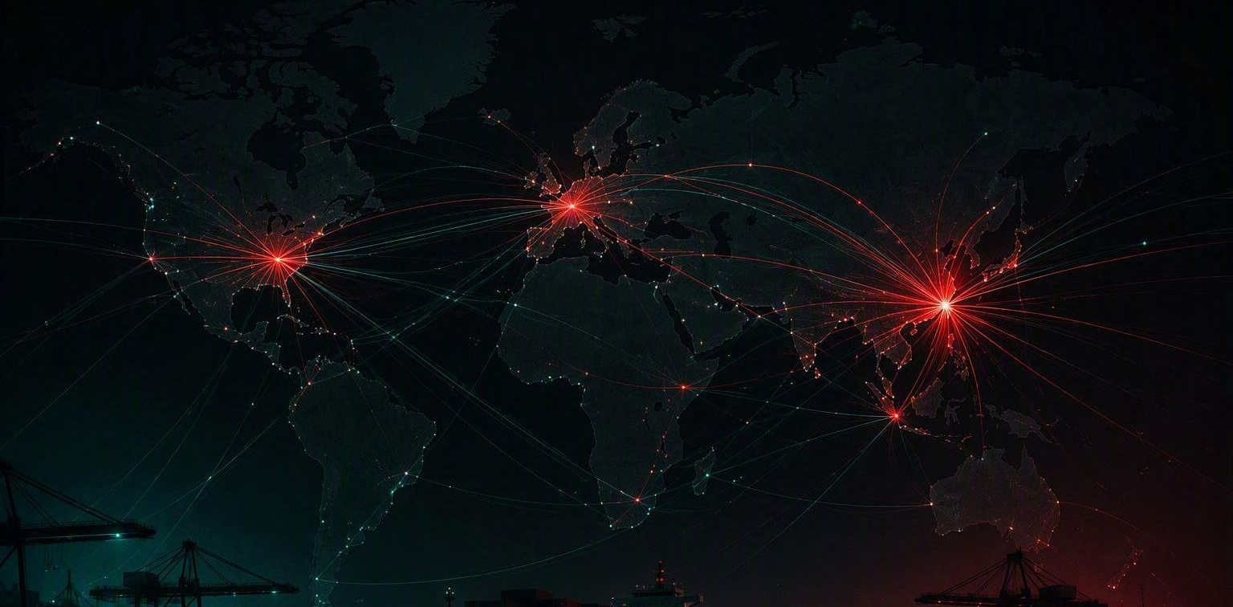
Structural upgrading was accompanied by greater concentration risk
!
GVC Position vs Concentration Risk
(2000; 2024)
High
High value-added
Low concentration
High value-added
High concentration
Higher value-added.
But, higher concentration risk.
Upgrading through deeper regional linkages also narrows exposure to fewer partners and sectors.
Value-added
Low value-added
Low concentration
Low value-added
High concentration
Low
Low
High
Concentration risk
Source: ADB; OECD Pass Through Frequency (PTF) Indicator; AMRO Staff Calculations.
Note: ROW = Rest of the world. The y-axis represents each economy’s value-added exports in high-value sectors as a share of its total value-added exports. High-value sectors are defined by the OECD as sectors with a high R&D spending as a share of global value-added. The x-axis shows the normalized Herfindahl–Hirschman Index (HHI) of PTF. For each producer–supplier economy pair, PTF values are aggregated across sectors before computing the index.

Slide 16
Deeper integration brings new opportunities and vulnerabilities
Deeper Regional Integration
BENEFITS
RISKS
Buffers external shocks through stronger intra-regional demand
Higher cyclical exposure to shared regional business cycles
Supply-chain diversification cushions disruptions within the region
Concentration risk raises vulnerability to targeted disruptions
Value-chain upgrading boosts productivity and income gains
Faster contagion transmits shocks through trade and financial channels
Source: AMRO staff

Slide 17

Thank you
Scan to download AREO 2026
Summary available in 10 ASEAN+3 languages
Contact Us
Add: 10 Shenton Way, #15-08/9, Singapore 079117
Tel: +65 6323 9844
Email: RegionalTeam@amro-asia.org
Website: www.amro-asia.org

